Slide 1
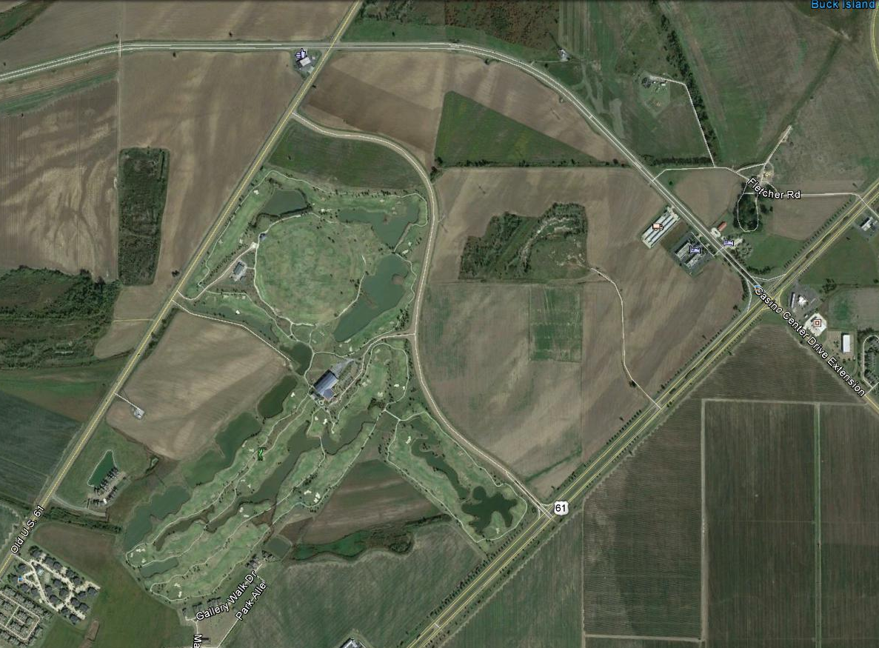
2013 Mississippi State University/Monsanto Company Pigweed Field Day Location
Old Highway 61
Field Day Location
Tunica National Golf Course
Field Entrance
Wendy’s Restaurant
Highway 61

